Slide 1
Territory Management Solution | Project Requirement
September 2016

Slide 2

The Territory management solution will have a structure to include functionalities for admins and End-users
Channel - 1
End-User Only
The end user directly interacts with the solution and makes the necessary changes
Data Layer
A
Salesforce
Saved Admin views
ERP
Attributes and Dimensions
Flat files
Channel - 2
Admin
The Admin configures the attributes, heat maps, tree maps, alignment in the solution.
The Salesforce attributes will then be transferred back to the data-layer, thus closing the loop of data transfer
Channel - 2
End-User
The configuration made by the admin will then roll out to the end-user.
The alignment changes made by the end-user will be uploaded on a daily basis to Salesforce
B
A
B

Slide 3
TMS, a territory management solution will have features both, for the Admins and the direct end users
Definition
The Territory Management solution (TMS) will be web-based application integrated with Salesforce for End-users such as Branch / District / Region Managers to re-align, monitor and measure performance of their territories in a seamless and user intuitive way.
The solution will have 2 user interfaces for two different set of users with the following features
Administrator
End - User
Customizable Heat-maps for the “Tree-map” as well as the “geo-spatial alignments”. a. Select pre-processed variables to populate the zip-level heat-map with pre-defined segments b. Select pre-processed variables to populate zip-level heat-map by user-defined boundaries and number of segments
Access control over the metrics to be viewed at a during the re-alignment process / zip-level view Admins will have access to select pre-processed variables aggregated at zip / territory level to view during the re-alignment process / zip level view.
Territory comparison The end-user will be able to compare territory performance against existing territories falling within his branch / region through the “Tree-map” interface
Heat-map / Zip-level view This feature will enable end-users to assess their territory at a zip level through pre-built and / or customized heat maps based on a few pre-processed KPIs
Territory re-alignment End-users will be able to re-align territories by moving zip codes across territories. The end-user will also be able to save, reload and execute pre-saved versions of zip-code alignments

Slide 4
The TM product will be built in order to change it from being a solution to a generic product
Solution Components and development stages
Present Solutions
Data input Layer
Front-end Parameters
User Interface
The data input layer is configured by Tredence by finalizing the data sources after discussing with the client
This layer cannot be tinkered with once Tredence has built it
Front-end parameters are hard-coded by Tredence by consulting with the client
This exercise is carried out only once, while developing the solution
The UI components such as Tree- map , heat-maps, KPI list etc. are fixed and cannot be changed
Proposed Product
Data input Layer
Front-end Parameters
User Interface
This layer will be dynamic wherein the admin will have functionalities to upload any data –set he needs as per his / her own will
The admin should also be able to aggregate / merge the newly uploaded data with existing tables in the back-end
The admin can change any parameters he wishes to and then push it to the “End-users”
The admin will also have functionalities to create new heat-maps with variable thresholds and push it to the front-end
The Admin will have access to modify the types of Heat-maps, tree-maps and KPI sets which the user currently views.
The admin will also have a work-bench to play around with variables and add / drop / modify new heat-maps / geo-locations etc.

Slide 5
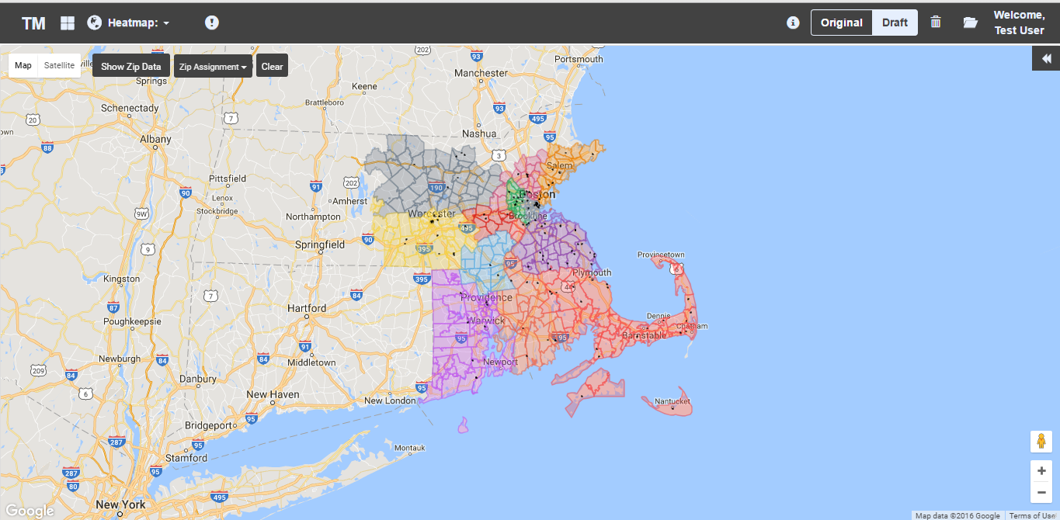
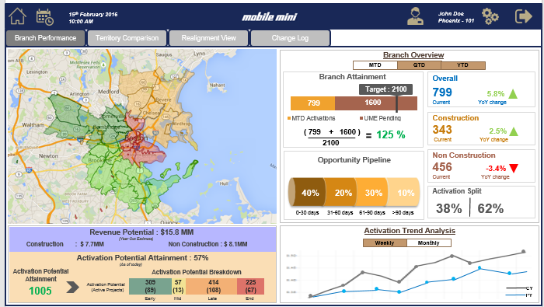
The resultant product will be a combination of two different solutions
Present Solution
The present solutions have an interactive UI with a fixed audience type
Proposed Product
Data input Layer
Front-end Parameters
User Interface
The admin can change any parameters he wishes to and then push it to the “End-users”
The admin will also have functionalities to create new heat-maps with variable thresholds and push it to the front-end
The Admin will have access to modify the types of Heat-maps, tree-maps and KPI sets which the user currently views.
The admin will also have a work-bench to play around with variables and add / drop / modify new heat-maps / geo-locations etc.

Slide 6
End-User UI

Slide 8
The End-users will have a birds-eye view of their territory upon signing into the solution

Slide 9
End-user feature list
2
3
6
4
5
1
1
3
The Heat-map button will help in changing KPIs which will populate the heat -map
5
The re-alignment panel will help analyze the impact of the zip movement across different KPIs
End-user will view the tree-maps in this
Functionality to compare territory / rep performance
Tree maps options which will enable end user to compare across dimensions
The End-user will have the feature to align zip –codes through the map
Users will be able to overlay any pre-saved zip-alignment on the map
2
4
6

Slide 10
The end-user can view the “Tree-map” by clicking on the “Top left minimizer”.
The user can use the above arrow to
Access the tree map

Slide 11

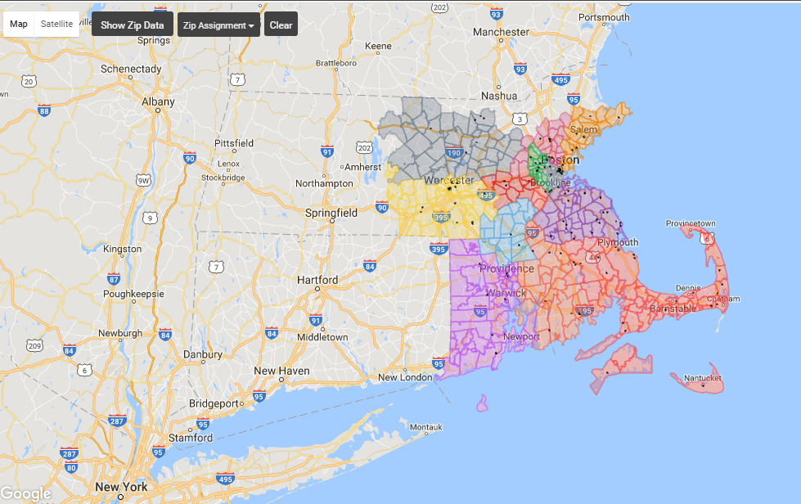
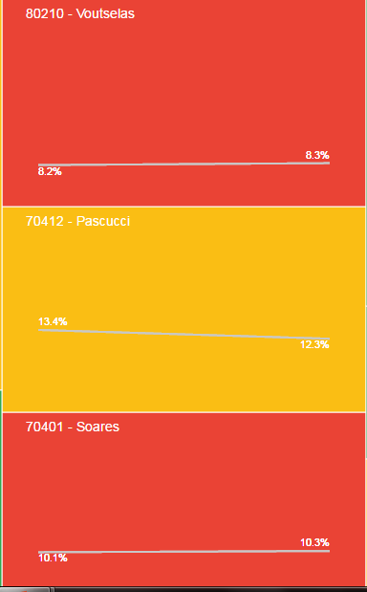
The user will have a feature to view the performance of their territories across multiple metrics

Slide 12
The Tree map will have multiple features to enable the end user to compare performances of his sales representatives
Initially the tree map will be colored as per the Territory color.
A functionality to click on the territory and highlight the corresponding area on the map will also be provided
Upon click of the “TM”, the dropdown will appear giving the user choices to select the metrics
Tree map colors will change as per the rep’s performance for that particular metric
A functionality to click on the territory and highlight the corresponding area on the map will also be provided

Slide 13
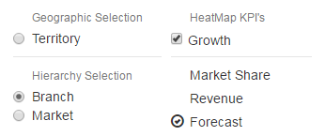
The end-user will have the feature to customize the Tree-map across multiple facts and dimensions

Slide 14
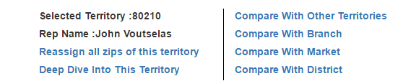
Upon Click of a button, the following dropdown will appear, enabling the user to compare territories within branches / markets et al.

Slide 15
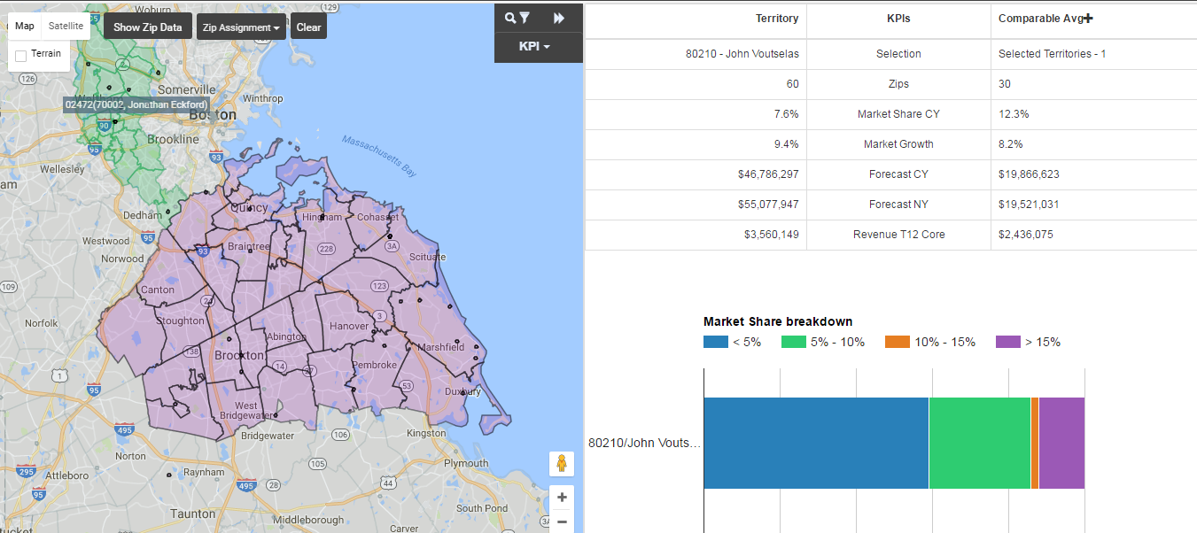
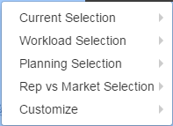
The following window appears once the user compares territories amongst each other

Slide 16
The comparison on the right will change upon clicking on any of the metrics on the left. We can add more BI in this part of the solution

Slide 17
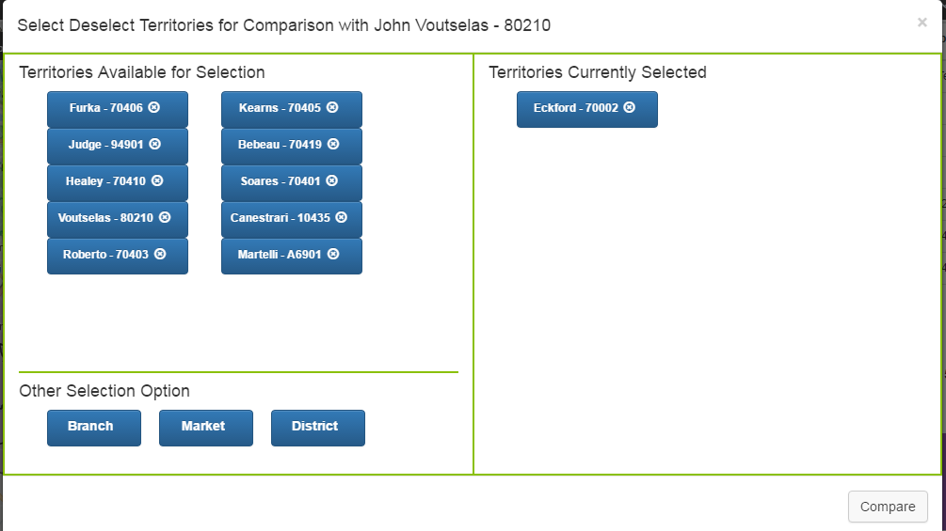
Users can also add territories to compare at a later stage. However, this needs to be made more intuitive

Slide 18
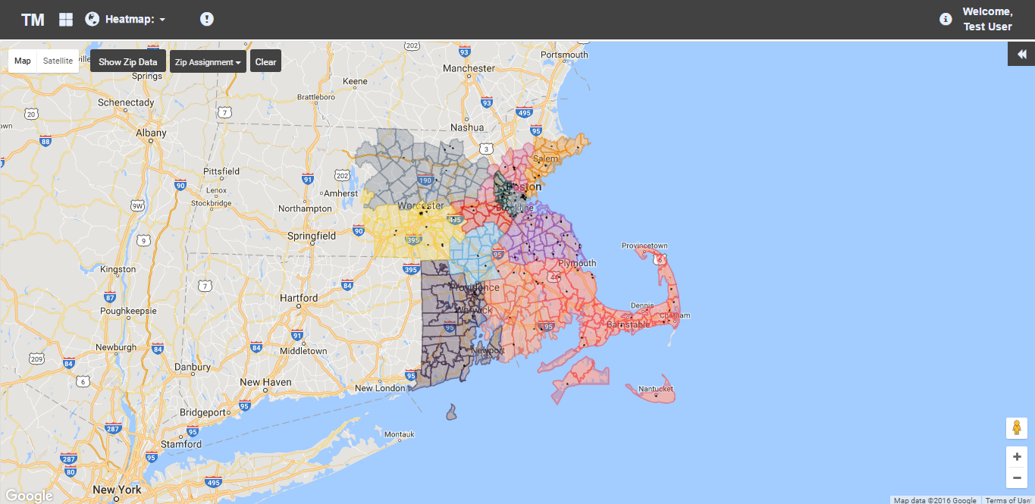
The End-users will also have a feature to view heat-maps by clicking on the “Globe” in the toolbar below

Slide 19
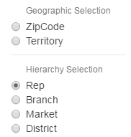
The heat-map can be configured by changing the dimensions and variables
The representation of the Drop down needs to be made more User intuitive. Tredence will ensure it is represented in a better way as compared to the present status

Slide 20
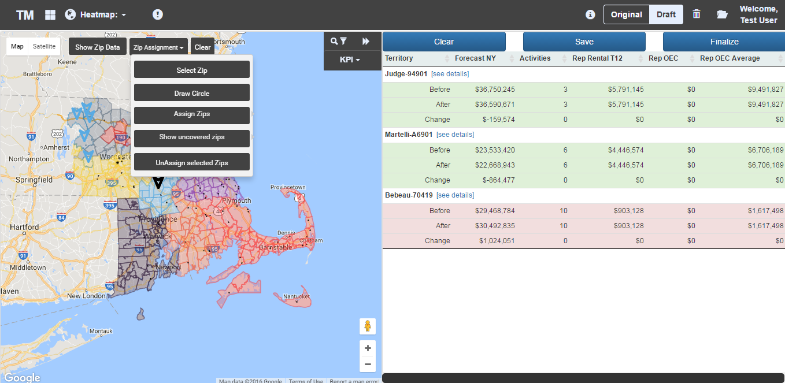
Users can realign territories by clicking on multiple zip codes or move complete territories and view the impact of the movement
This view lacks intuitiveness and will be changed by showing Graphs of the “Before” and “After” re-alignment instances. (As shown by Mark)
Users will be able to make multiple zip movements
A feature to enable users to save multiple iterations of their zip alignments

Slide 21
Thank you

